Slide 1
Computer Networks
Chapter 2.2
ALOK KUMAR – ASSISTANT PROFESSOR & KARGIL TECHINCAL TRAINER (DCPD)
EMAIL: DCPD.KARGILT1@CUMAIL.IN

Slide 2
Contents
Routing.
Distance Vector Routing(Concept, Bellman Ford, Working, Numerical Examples, Count-to-infinity problem, Adv & Disad)
Link State Routing(Concept, Dijkstra Algo Logic, Examples, Adv & Disad)
Hierarchical Routing
Broadcast Routing(Concept, Flooding & Techniques, Problems with Simple flooding, Controlled Flooding Methods, Spanning Tree Routing)
Shortest Path Algorithm
Unicast Routing(Concept, Dijkstra Algo logic, Link state vs Distance Vector)
DHCP
VLAN

Slide 3
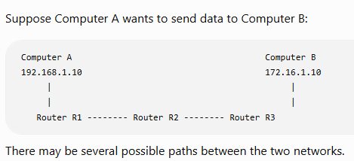
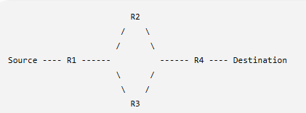
Introduction to Routing
What is Routing?
Routing is the process of finding a suitable path for sending an IP packet from a source network to a destination network.
When the source and destination are on different networks, the packet usually passes through one or more routers.
The router has to decide:
Which path should be used to reach the destination network?
This process of learning/selecting a path is called Routing.

Slide 4
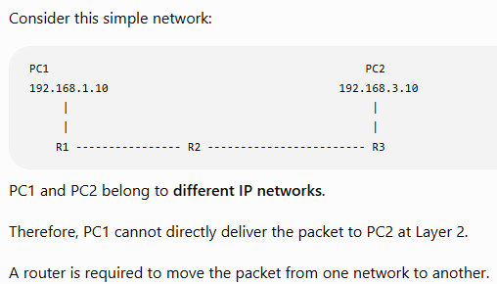
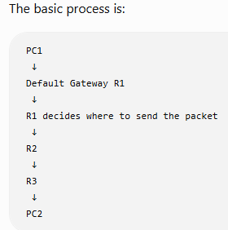
Why is Routing Required?
Therefore:
Routing is required when packets have to travel between different IP networks.

Slide 5
Routing vs Forwarding
They are related, but they are not exactly the same.
Routing
Routing means: Finding/learning the path to a destination.
Forwarding
Forwarding means:
Actually sending a received packet through the correct outgoing interface/next hop.
Example:
R1 learns:
Network 192.168.3.0/24
can be reached through R2
Example:
Packet arrives at R1
Destination = 192.168.3.10
R1 checks its routing table
192.168.3.0/24 → R2
R1 forwards packet toward R2

Slide 6
Difference
Routing | Forwarding
Finds/learns the path | Sends the actual packet
Builds/maintains routing information | Uses routing/forwarding information
Concerned with path selection | Concerned with packet movement
Example: “Use R2 to reach Network B” | Example: “Send this packet to R2”
ROUTING
"Which road should I use?"
↓
Path is learned
↓
FORWARDING
"Send this packet on that road."

Slide 7
What is a Route?
A route is information that tells a router how a particular destination network can be reached.
For example:
Destination Network: 192.168.20.0/24
Next Hop: 10.0.0.2
It simply means:
To reach 192.168.20.0/24, send the packet toward router 10.0.0.2. A router can contain many such routes.
What is a Routing Table?
A routing table is a table maintained by a router containing information about how different destination networks can be reached.
Think of it as a router's road map.

Slide 8
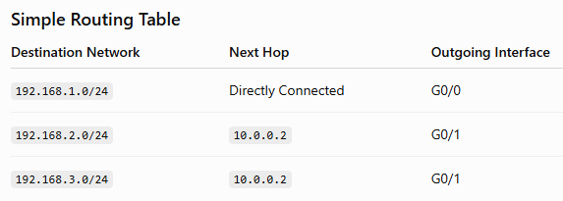
What is a Routing Table?
Suppose a packet arrives with:
Destination IP = 192.168.3.25
Router checks:
192.168.3.25
↓
Belongs to
192.168.3.0/24
↓
Routing table says
Next Hop = 10.0.0.2
↓
Send through G0/1

Slide 9
What is a Destination Network?
Routers normally make forwarding decisions based on the destination IP address and matching network prefix.
Suppose the destination computer is: 192.168.20.25
and the routing table contains: 192.168.20.0/24
The router understands that: 192.168.20.25
belongs to: 192.168.20.0/24
Therefore, it uses that matching route.
Example
Destination IP
192.168.20.25
↓
Matching Route
192.168.20.0/24
↓
Next Hop
10.0.0.2

Slide 10
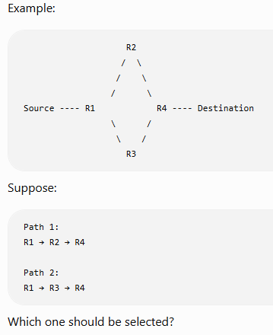
What is a Metric?
Sometimes there can be more than one possible route to a destination.
Routing protocols use a value called a Metric.
Metric is a value used by a routing protocol to compare routes and help select a preferred path.
Different routing protocols can use different metrics.
Examples include:
Hop count
Link cost
Bandwidth-related cost
Delay
Other protocol-specific values

Slide 11
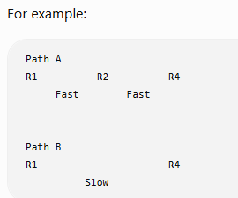
Does the Shortest Path Always Mean Physically Shortest?
In networking:
Shortest path usually means the path with the lowest routing metric/cost—not necessarily the shortest physical distance.
It generally means:
Best/least-cost path according to the routing metric
Physically, Path B may look shorter.
But depending on the routing protocol and metric, Path A may have a better routing cost.

Slide 12
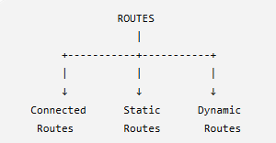
How Does a Router Learn Routes?

Slide 13
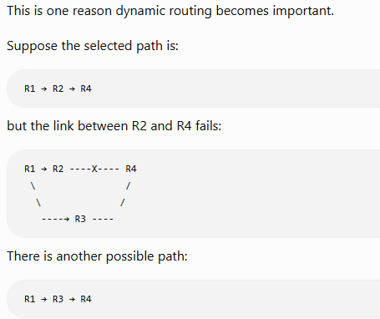
What Happens When a Link Fails?
With properly configured dynamic routing, routers can learn about the topology/route change and eventually select another available path.
This process is related to: Convergence

Slide 14
What is Convergence?
Convergence is the process/state in which routers have updated and reached a consistent understanding of the available routes after a network change.
Example:
Initially:
R1 → R2 → R3
Then a link fails:
R1 → R2 --X-- R3
Routers need some time to:
Detect failure
↓
Exchange/update routing information
↓
Calculate/select new routes
↓
Routing information becomes stable
When the routers have updated to the new network condition, the routing system is said to have converged.
Convergence is the process of routers updating their routing information until they agree on the current reachable paths after a change.
Important to understand for Distance Vector & Link State Routing.

Slide 15
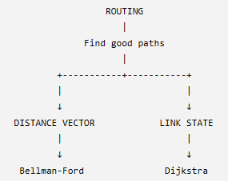
What is a Routing Algorithm?
A routing algorithm is the logic used to determine good routes through a network
For now, simply remember:
Distance Vector
A router mainly learns routing information from its neighbors.
It uses: Bellman-Ford Logic
Link State
Routers build a view of the network topology and calculate best paths.
It uses: Dijkstra’s algorithm​s

Slide 16
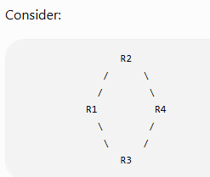
Topic 2: Shortest Path / Least-Cost Path Concept
You should first understand one simple question:
If multiple paths are available to reach a destination, how does a router decide which path is better?
This is the basic idea behind Shortest Path Routing.
What is a Path?
A path is a sequence of routers/links through which a packet can travel from a source to a destination.
There are two possible paths:
Path 1:
R1 → R2 → R4
Path 2:
R1 → R3 → R4
Both paths can reach the same destination.
So the router needs some method to decide:
Which path should I choose?
Suppose R1 wants to reach R4.

Slide 17
What is the Shortest Path?
The Shortest Path is the best path from a source to a destination according to a particular metric or cost.
The word shortest does NOT always mean physically shortest distance.
in networking:
Shortest Path usually means the path having the lowest calculated routing cost according to the metric being used.
Also called as: Least-Cost Path

Slide 18
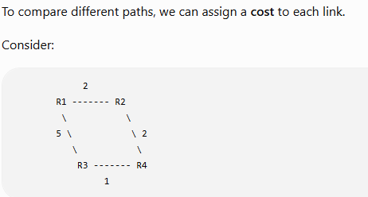
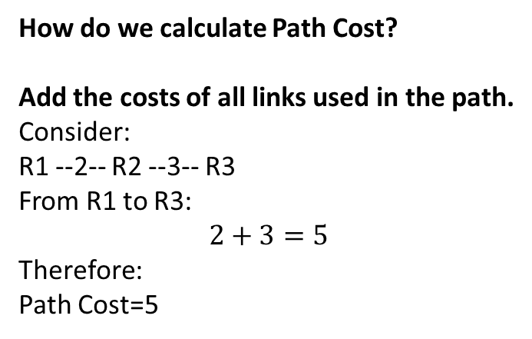
What is Cost?
For example:
R1 → R2 = Cost 2
R2 → R4 = Cost 2
R1 → R3 = Cost 5
R3 → R4 = Cost 1
How do we calculate Path Cost?
Add the costs of all links used in the path.
Consider:
R1 --2-- R2 --3-- R3
From R1 to R3:
$$2+3=5$$
Therefore:
Path Cost=5​
The numbers:
2
5
2
1
represent the cost of the links.

Slide 19
What Can Be Used as a Routing Metric?
Different routing protocols can measure a route differently.
A metric may be based on factors such as:
Metric | Simple Meaning
Hop Count | Number of routers/hops
Cost | Assigned value for a link/path
Bandwidth | Capacity/speed of the link
Delay | Time required to send data
Reliability | How reliable/stable the link is
Load | How busy the link is
The best route depends on the metric used by the routing protocol
Hop Count Example
Suppose:
Path A:
R1 → R2 → R3 → R6
Hop Count: 3
Different routing protocols use different approaches.
For example:
RIP
↓
Hop Count
OSPF
↓
Cost

Slide 20
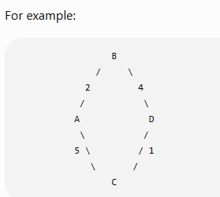
Representing a Network as a Graph
Routing algorithms often represent a network using a graph.
It is simply a network diagram.
The connections:
A — B
A — C
B — D
C — D
are called: Links or Edges
The numbers:
2, 5, 4, 1
are: Link Costs
Here:
A, B, C, D
are called: Nodes
In networking, nodes can represent routers.

Slide 21
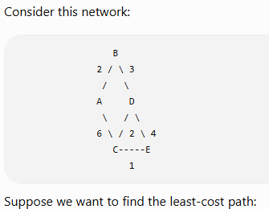
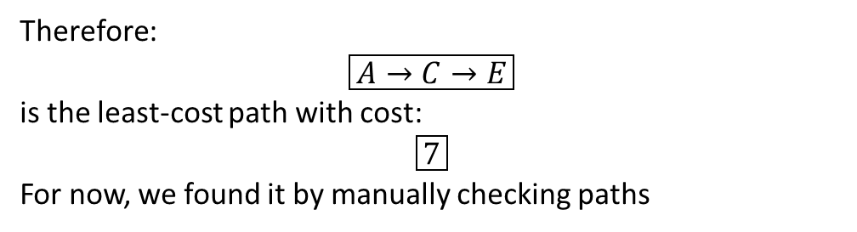
Numerical Example
Path 2
A → B → D → E
Cost:
2+3+4=9
Path 3
A → B → D → C → E
Cost:
2+3+2+1=8
A → E
Possible paths include:
Path 1
A → C → E
Cost:
6+1=7
Therefore:
$$\boxed{A→C→E}$$
is the least-cost path with cost:
$$\boxed{7}$$
For now, we found it by manually checking paths

Slide 22
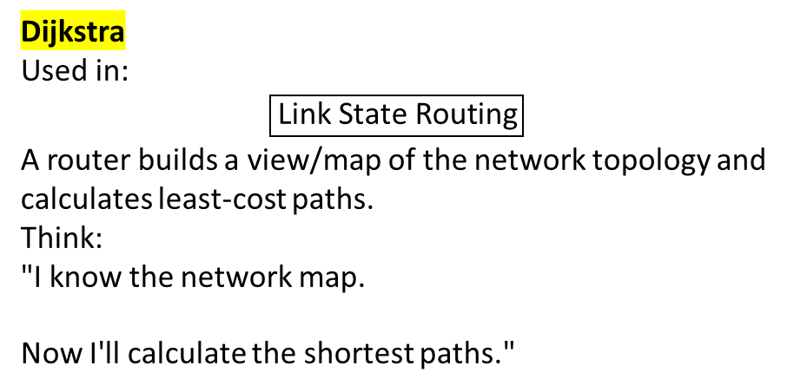
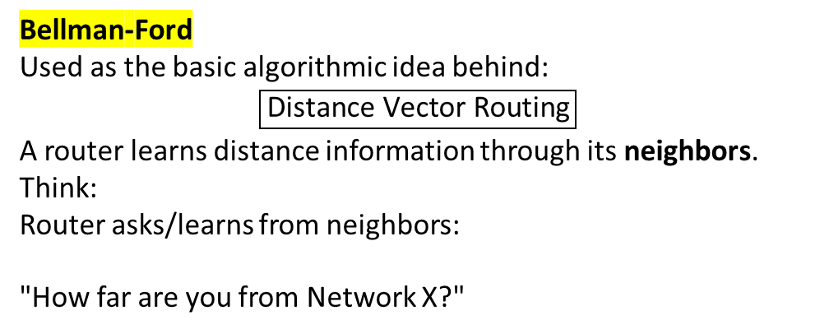
Bellman-Ford vs Dijkstra — Just the Basic Idea
Bellman-Ford
Used as the basic algorithmic idea behind:
$$\boxed{\text{Distance Vector Routing}}$$
A router learns distance information through its neighbors.
Think:
Router asks/learns from neighbors:
"How far are you from Network X?"
Dijkstra
Used in:
$$\boxed{\text{Link State Routing}}$$
A router builds a view/map of the network topology and calculates least-cost paths.
Think:
"I know the network map.
Now I'll calculate the shortest paths."
Distance Vector | Link State
Bellman-Ford | Dijkstra
Learns through neighbors | Builds topology information
Distance-based calculations | Shortest-path calculation from topology

Slide 23
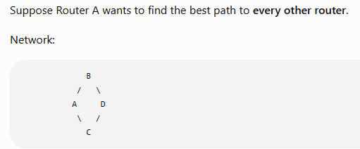
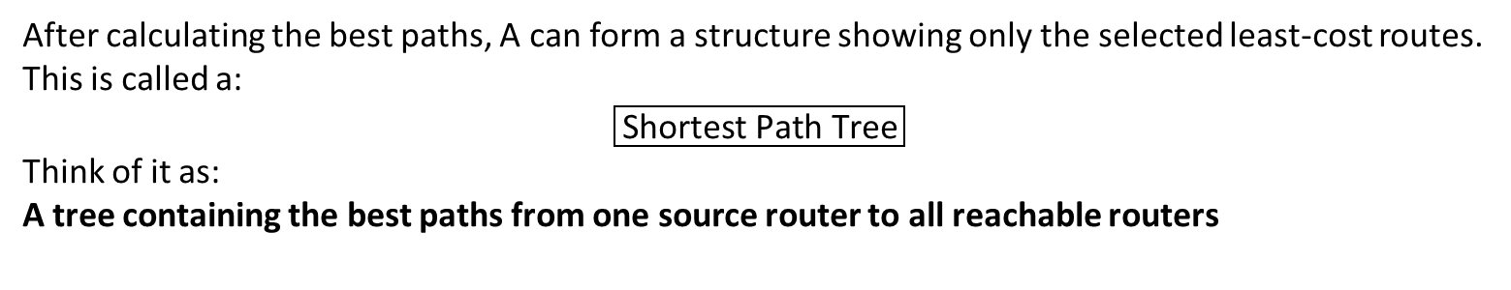
What is a Shortest Path Tree?
After calculating the best paths, A can form a structure showing only the selected least-cost routes.
This is called a:
$$\boxed{\text{Shortest Path Tree}}$$
Think of it as:
A tree containing the best paths from one source router to all reachable routers

Slide 24
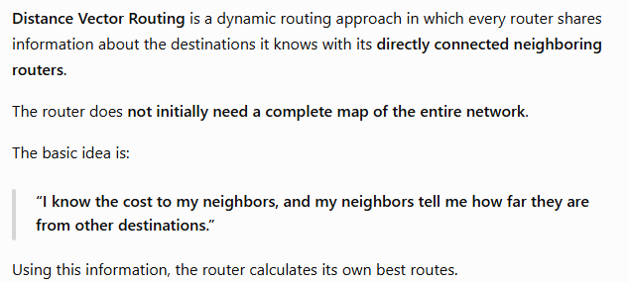
What is Distance Vector Routing?

Slide 25
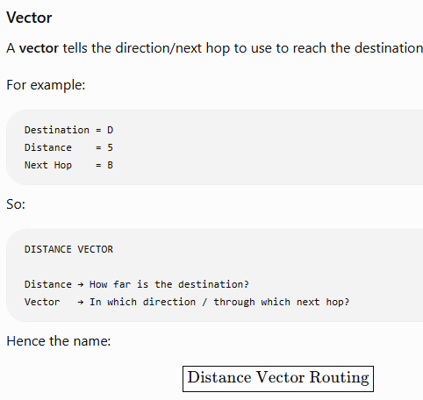
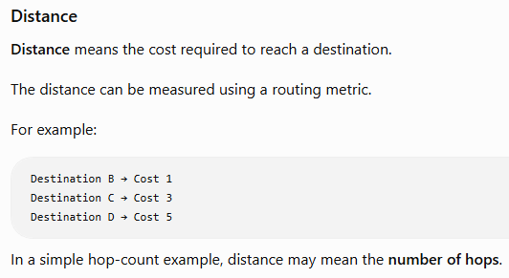
What is Distance Vector Routing?

Slide 26
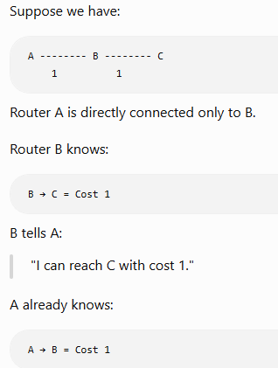
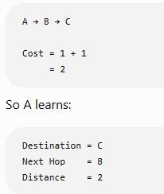
Example:

Slide 27
What Information Does a Router Maintain?:
Destination | Distance/Cost | Next Hop
A | 0 | Self
B | 1 | B
C | 2 | B
D | 4 | B
For Router A, this means:
Destination A
Cost = 0
Because I am A.
Destination B
Cost = 1
Reach directly through B.
Destination C
Cost = 2
Reach through B.
Destination D
Cost = 4
Reach through B.

Slide 28
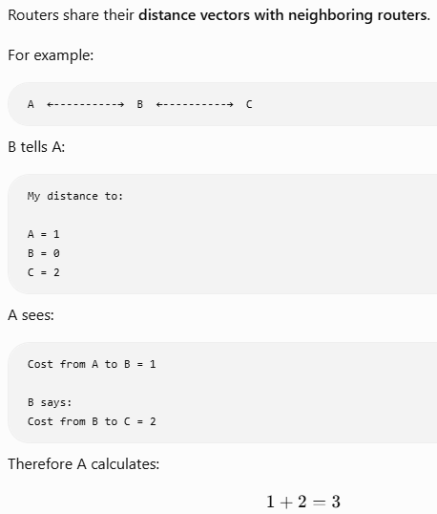
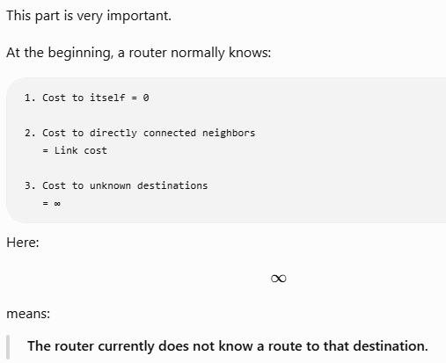
What Does a Router Know Initially?

Slide 29
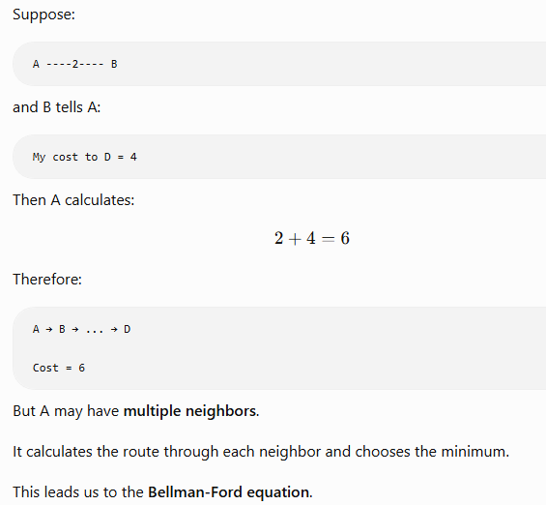
Main Rule of Distance Vector Routing
The basic calculation is: Cost through a neighbor = Cost to that neighbor + Neighbor's cost to destination

Slide 30
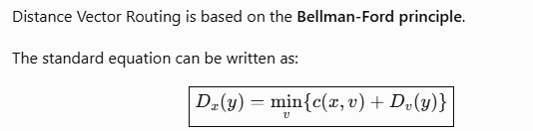
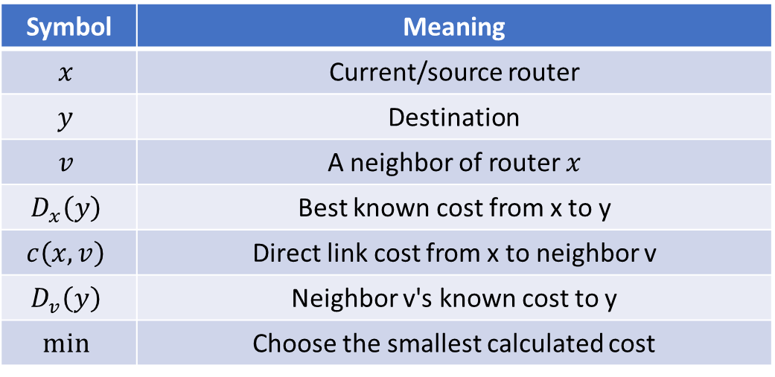
Bellman-Ford Equation
Symbol | Meaning
$$x$$ | Current/source router
$$y$$ | Destination
$$v$$ | A neighbor of router $x$
$$D_{x}\left(y\right)$$ | Best known cost from x to y
$$c\left(x , v\right)$$ | Direct link cost from x to neighbor v
$$D_{v}\left(y\right)$$ | Neighbor v's known cost to y
$$min$$ | Choose the smallest calculated cost
My cost to destination
=min(cost to neighbour + neighbour's cost to destination)

Slide 31
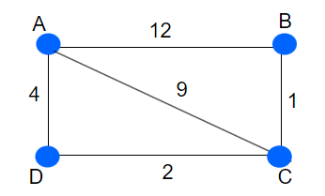
Example 1
The basic idea of Distance Vector Routing Algorithm is to determine the best path to travel.
Least Cost Path.
Every Router Consist of Routing table having 3 fields [Destination | Distance | Next Router]
Every router shares its routing table [distance vector] with its neighbor routers, and based
upon that every router updates.
Step1:
A
B
C
D
Dest. | Dist. | Next Hop
A | 0 | A
B | 12 | B
C | 9 | C
D | 4 | D
Dest. | Dist. | Next Hop
A | 12 | A
B | 0 | B
C | 1 | C
D | ∞ | -
Dest. | Dist. | Next Hop
A | 9 | A
B | 1 | B
C | 0 | C
D | 2 | D
Dest. | Dist. | Next Hop
A | 4 | D
B | ∞ | -
C | 2 | C
D | 0 | D

Slide 32
Example 1
In step 2, every router will share its routing table [Distance Vector] with neighbors.
Now earlier for router A, Going from A to B was 12,
and now after sharing distance vectors,
we can go like: A -> B = A ->C + C -> B
= 9 + 1 = 10
Compare: min (12, 10) = 10
Now earlier for router A, Going from A to B was 12,
and now after sharing distance vectors,
we can go like: A -> B = A ->D + D -> C + C -> B
= 4 + 2 + 1 = 7
Compare: min (12, 7) = 7
Hence, this will be updated in A’s routing table.
Step 2:
A
B
C
D
Dest. | Dist. | Next Hop
A | 0 | A
B | 7 | D, C
C | 6 | C
D | 4 | D
Dest. | Dist. | Next Hop
A | 7 | C, D
B | 0 | B
C | 1 | C
D | 3 | C, D
Dest. | Dist. | Next Hop
A | 6 | D
B | 1 | B
C | 0 | C
D | 2 | D
Dest. | Dist. | Next Hop
A | 4 | A
B | 3 | C
C | 2 | C
D | 0 | D
New Routing Tables

Slide 33
Final Least Cost
From / To | A | B | C | D
A | 0 | 7 | 6 | 4
B | 7 | 0 | 1 | 3
C | 6 | 1 | 0 | 2
D | 4 | 3 | 2 | 0

Slide 34
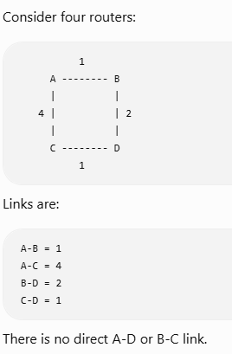
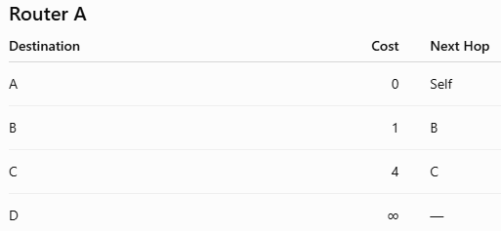
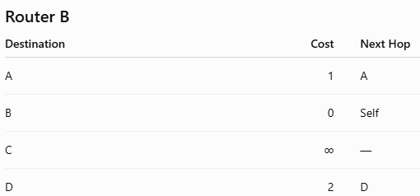
Example 2
Step 1 — Initial Distance Vectors
Initially each router knows itself and its direct neighbors.

Slide 35
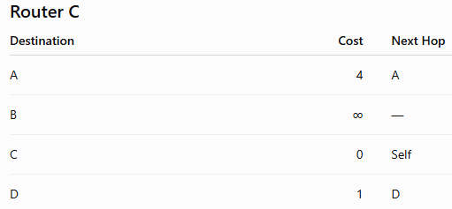
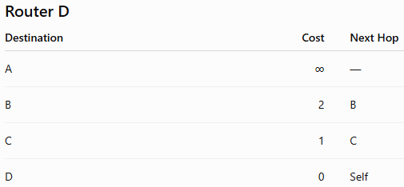
Example
Step 2 — Routers Exchange Information
Let's focus on Router A first.
A has two neighbours: B and C
A receives their distance vectors.
B says:
A = 1
B = 0
C = ∞
D = 2
C says:
A = 4
B = ∞
C = 0
D = 1
A wants to determine the best route to D.
At this point: ∞ = Route currently unknown

Slide 36
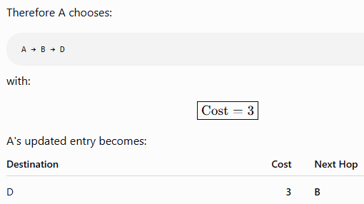
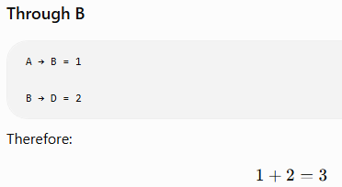
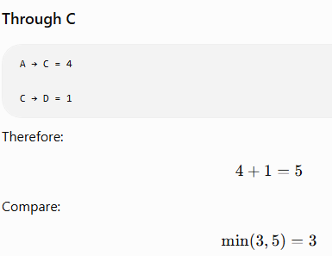
Example
A Calculates Route to D

Slide 37

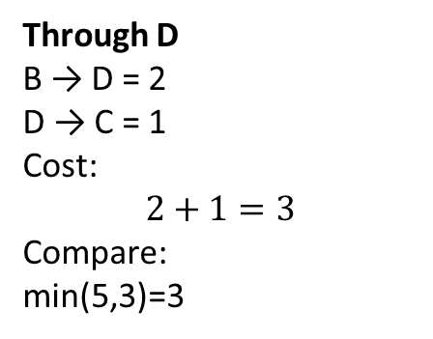
Example
B Calculates Route to C
B's neighbors are: A and D
Through A
B → A = 1
A → C = 4
Cost:
1+4=5
Through D
B → D = 2
D → C = 1
Cost:
$$2+1=3$$
Compare:
min(5,3)=3
Therefore:
B → D → C
is selected.

Slide 38
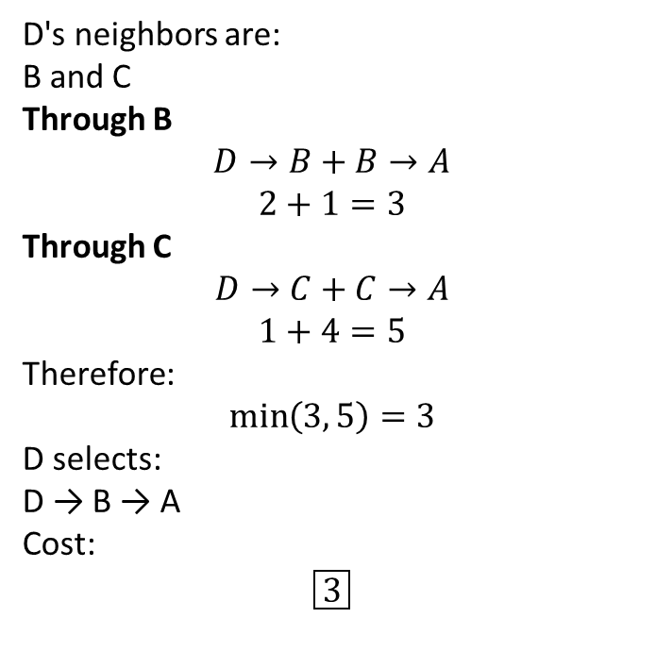
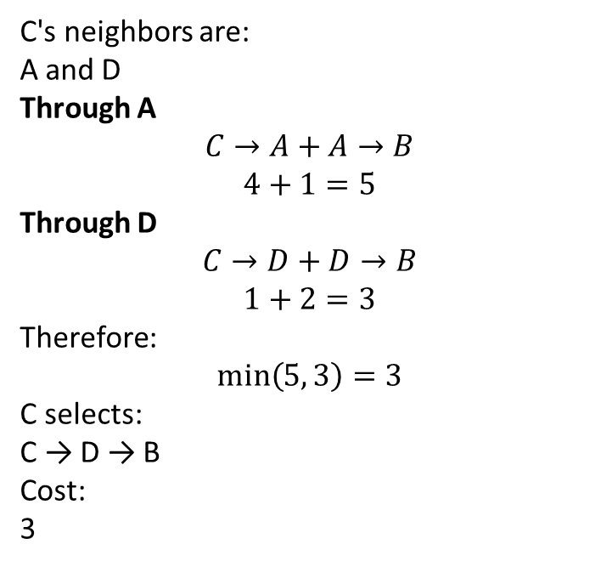
Example
C Calculates Route to B
D Calculates Route to A
D's neighbors are:
B and C
Through B
$$D→B+B→A$$
$$2+1=3$$
Through C
$$D→C+C→A$$
$$1+4=5$$
Therefore:
$$min⁡\left(3 , 5\right)=3$$
D selects:
D → B → A
Cost:
$$\boxed{3}$$
C's neighbors are:
A and D
Through A
$$C→A+A→B$$
$$4+1=5$$
Through D
$$C→D+D→B$$
$$1+2=3$$
Therefore:
$$min⁡\left(5 , 3\right)=3$$
C selects:
C → D → B
Cost:
3

Slide 39
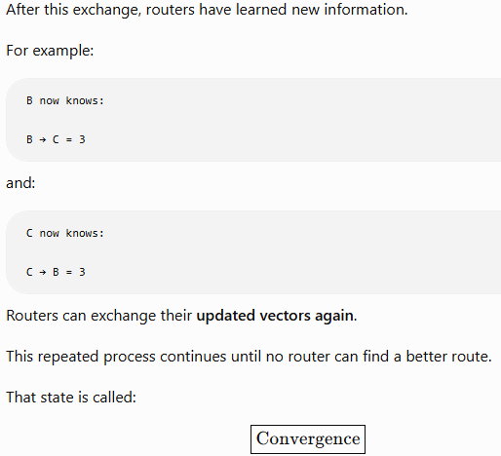

Slide 40
Final Least Costs
From / To | A | B | C | D
A | 0 | 1 | 4 | 3
B | 1 | 0 | 3 | 2
C | 4 | 3 | 0 | 1
D | 3 | 2 | 1 | 0

Slide 41
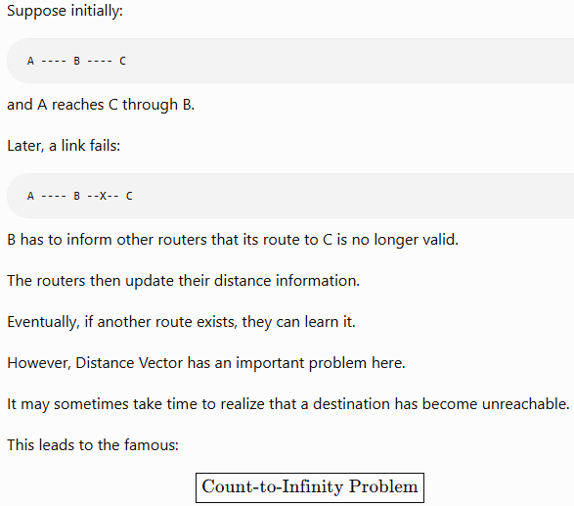
What Happens When Network Conditions Change?

Slide 42
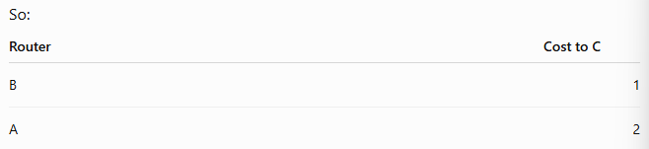
What Happens When Network Conditions Change?
This is one of the most important disadvantages of Distance Vector Routing.
Initially:
A -------- B -------- C
1 1
Suppose C represents a destination/network.
Initially:
B → C = 1
A → C = 2
through B

Slide 43
What Happens When Network Conditions Change?
Initially:
A -------- B -------- C
1 1
So B updates:
B → A → C = 3
But where was A actually going to reach C?
Through B!
A → B → C
So we have created a routing loop.
Now suppose: B ----X---- C
The link between B and C fails.
B should understand: C = unreachable
But a problem can occur if B receives old information from A saying: A → C = 2
B may incorrectly think:
"A can reach C with cost 2. I can reach A with cost 1. Therefore, I can reach C through A with cost 3."

Slide 44
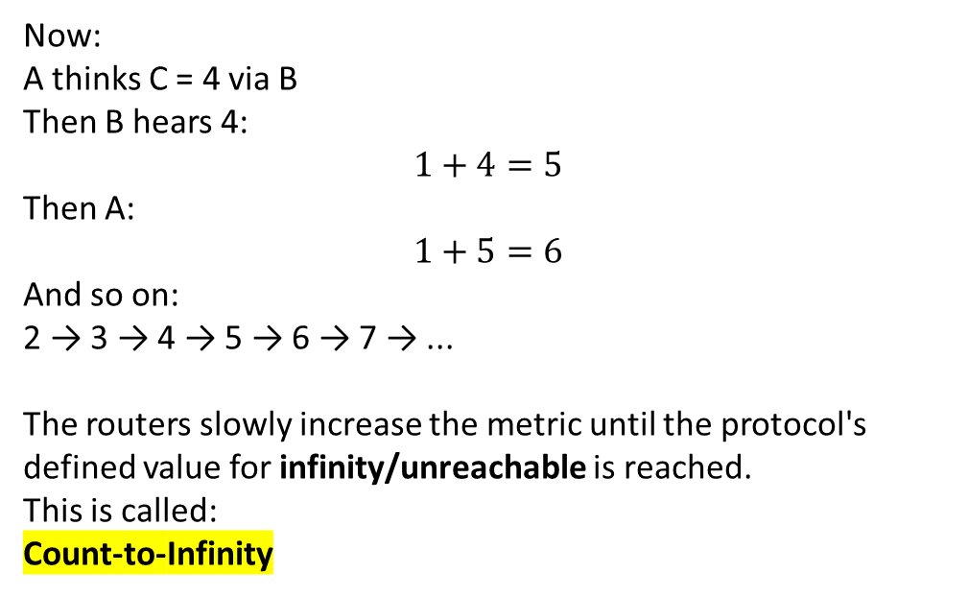
What Happens When Network Conditions Change?
Initially:
A -------- B -------- C
1 1
Now:
A thinks C = 4 via B
Then B hears 4:
$$1+4=5$$
Then A:
$$1+5=6$$
And so on:
2 → 3 → 4 → 5 → 6 → 7 → ...
The routers slowly increase the metric until the protocol's defined value for infinity/unreachable is reached.
This is called:
Count-to-Infinity
Before failure: B thinks C = 1
A thinks C = 2 via B
After failure, B may learn:
B thinks: C = 3 via A
Then A hears B saying 3.
A calculates:
1+3=4

Slide 45
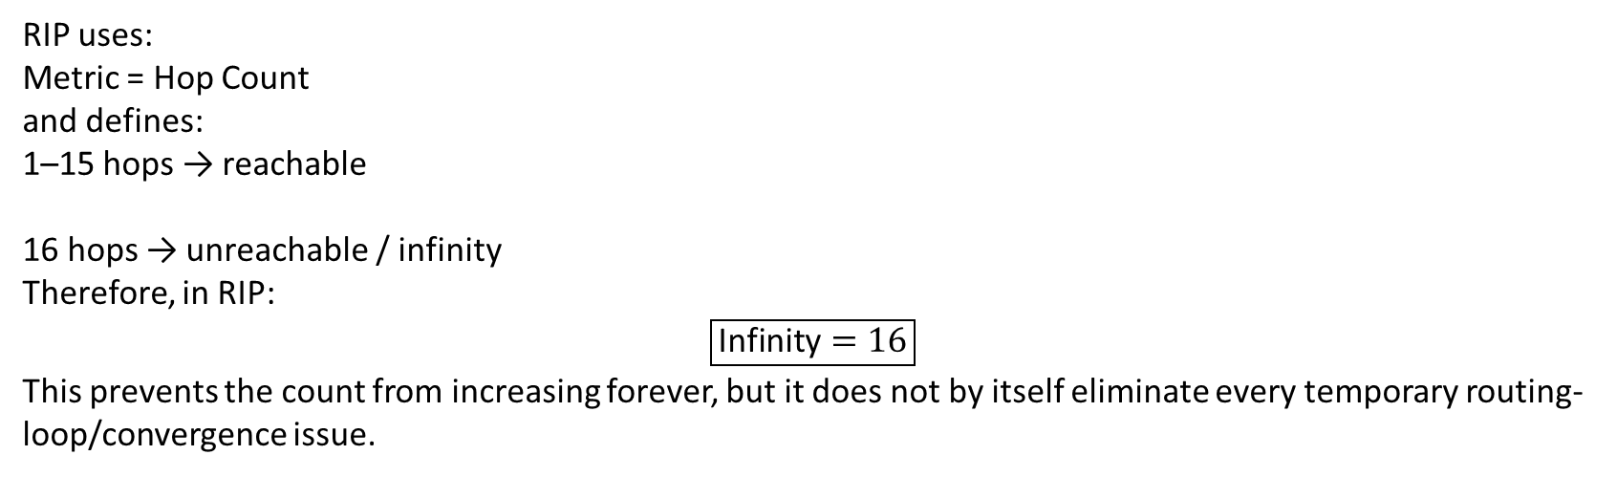
Count-to-Infinity in RIP
A common real-world example of Distance Vector routing is RIP — Routing Information Protocol.
RIP uses:
Metric = Hop Count
and defines:
1–15 hops → reachable
16 hops → unreachable / infinity
Therefore, in RIP:
$$\boxed{\text{Infinity}=16}$$
This prevents the count from increasing forever, but it does not by itself eliminate every temporary routing-loop/convergence issue.

Slide 46
Advantages of Distance Vector Routing
Advantage | Simple Explanation
Simple concept | Easy to understand and implement
Less topology knowledge required | Router does not need a complete topology map like Link State
Lower algorithmic complexity | Basic calculations are relatively simple
Suitable for smaller networks | Can work well where network size and complexity are limited
Automatic route learning | Dynamic protocol can learn/update remote routes without manually entering every route
Neighbor-based exchange | Routing information is exchanged with directly connected neighbors

Slide 47
Disadvantages of Distance Vector Routing
Disadvantage | Simple Explanation
Slower convergence | Can take longer for routing information to stabilize after changes
Count-to-Infinity | Failed routes may temporarily appear reachable with increasing metrics
Routing loops | Incorrect/stale information can create loops
Periodic update overhead | Traditional DV protocols such as RIP periodically exchange routing information
Limited scalability | Basic DV protocols such as RIP are not suitable for very large networks
Less topology visibility | A router does not have the same complete topology database as a Link State router

Slide 48
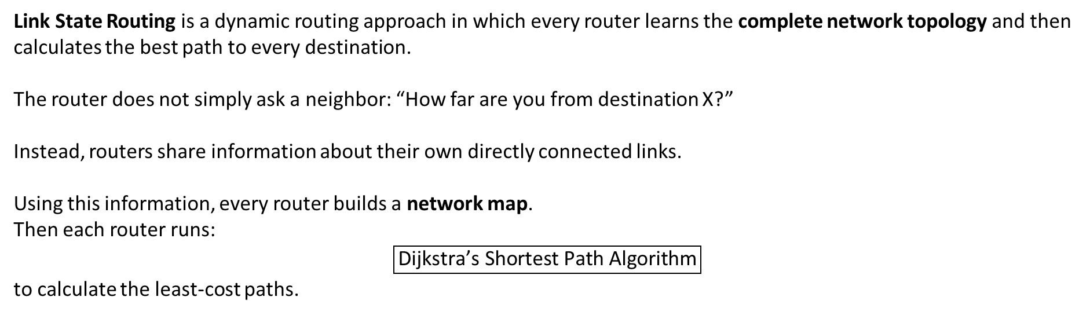
Link State Routing
Link State Routing is a dynamic routing approach in which every router learns the complete network topology and then calculates the best path to every destination.
The router does not simply ask a neighbor: “How far are you from destination X?”
Instead, routers share information about their own directly connected links.
Using this information, every router builds a network map.
Then each router runs:
$$\boxed{\text{Dijkstra’s Shortest Path Algorithm}}$$
to calculate the least-cost paths.
Link State Routing is a routing method in which routers share the state and cost of their directly connected links, build a complete topology map, and use Dijkstra's algorithm to find the shortest path.
The state tells information about that link.
For example:
Link is UP
Cost = 2
Connected Neighbor = R2
A link means the connection between two routers.

Slide 49
Main Difference from Distance Vector
This is the biggest conceptual difference.
Distance Vector
Router mainly learns:
Neighbor says:
"I can reach D with cost 4.“
Router does not necessarily know the complete path behind that information.
Think Like:
“My neighbor tells me the distance.”
Link State
Router learns:
1. Which routers are connected?
2. What are the link costs?
3. Which links are up or down?
Then it builds a topology map and calculates the path itself.
Think Like:
“I know the map, so I calculate the path myself.”

Slide 50
Complete Working of Link State Routing
Discover neighbours
↓
Measure link cost
↓
Create Link State information
↓
Flood this information to all routers
↓
Every router builds Link State Database
↓
Every router gets the topology map
↓
Run Dijkstra's Algorithm
↓
Build Shortest Path Tree
↓
Create Routing Table

Slide 51
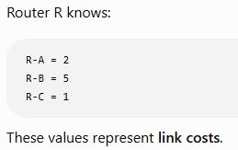
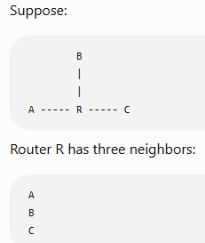

Step 1 — Discover Neighbours
Link State protocols use control messages to discover and maintain neighbor relationships.
The first job of a router is to identify its directly connected neighboring routers.
For example, OSPF uses Hello packets.
Step 2 – Find the cost of each link
The router then determines the cost of its directly connected links.
A link cost is a numerical value used to compare paths.
It can depend on protocol-specific rules.
For example, cost may reflect:
Bandwidth
Administrative cost
Other configured metric
It must know:
“Which routers are directly connected to me?”
Lower cost generally means a more preferred link.

Slide 52

Step 3 —Create Link State Information
Why Sequence Number is Used
Why Age / Lifetime is Used
After identifying neighbors and costs, a router creates a message describing its local links.
This is commonly called a:
$$\boxed{\text{Link State Advertisement (LSA)}}$$
or more generally a Link State Packet
Suppose an old LSA and a new LSA both exist.
The router must identify which one is newer.
Example:
LSA Sequence Number = 20
Later:
LSA Sequence Number = 21
The router understands:
21 is newer than 20
This helps prevent outdated topology information from replacing newer information.
Routing information should not remain forever.
If an old advertisement stays in the network even after it is no longer valid, routers may use stale information.
Therefore LSAs usually have some aging mechanism.
Conceptually:
LSA created
↓
Used for some period
↓
If not refreshed
↓
Eventually removed
This helps keep topology information current.
In simple form, it can contain:
Router identity
Neighbor information
Link cost
Link status
Sequence number
Age/lifetime information
TTL

Slide 53

Step 4—Flooding
Does Every Router Keep Forwarding the Same LSA Forever?
Now comes a very important concept.
Each router needs the link-state information to reach all relevant routers.
This is done using:
$$\boxed{\text{Flooding}}$$
In simple terms:
A router forwards newly received link-state information to its other neighbors so that the information spreads through the network.
Suppose:
A ---- B ---- C ---- D
A creates an LSA.
A sends it to B.
A → B
B receives it and forwards it toward C.
A → B → C
C forwards it to D.
A → B → C → D
Eventually, the information reaches all routers.
No.
That would create an infinite flood.
Routers use mechanisms such as:
1.Sequence Number
2.Age
3.Duplicate checking
to recognize whether an LSA is:
New
Old
Duplicate
If it is a duplicate, it does not need to be endlessly flooded again

Slide 54



The LSDB contains information similar to:
Step 5—Link State Database
Routers in the same Link State routing area/domain should have a consistent view of topology after convergence.
For example:
Router A → topology map
Router B → topology map
Router C → topology map
Router D → topology map
The topology information should agree.
However, each router calculates its own shortest path tree, because each router uses itself as the source.
After routers receive LSAs from all routers, they store the topology information in a:
$$\boxed{\text{Link State Database (LSDB)}}$$
The LSDB is like a map of the network topology.

Slide 55

Step 6—Run Dijkstra Algorithm
Dijkstra's Basic Logic
The update logic can be written as:
D(v)=min[D(v),D(u)+c(u,v)]​
D(v): Current best known cost to node v.
D(u): Best known cost to current node u.
C(u,v); Cost of link from u to v.
Min: Keep the smaller value.
Simple meaning:
New cost to neighbor = Current cost to current router + link cost
If the new value is smaller, update it.
Once a router has the topology map, it runs:
$$\boxed{\text{Dijkstra’s Shortest Path First Algorithm}}$$
The goal is:
Find the least-cost path from the current router to every other router/network.
Start from source router
↓
Give source cost 0
↓
All other routers initially ∞
↓
Select nearest unvisited router
↓
Check its neighbors
↓
Update costs if a cheaper path is found
↓
Mark router as selected/visited
↓
Repeat
↓
All shortest paths found
For example:
Source Router = A
A runs Dijkstra and determines:
Best path to B
Best path to C
Best path to D
Best path to E
...

Slide 56

Example 1
Link State Packets
A
Seq No
Age
B
Seq No
Age
C
Seq No
Age
D
Seq No
Age
B | 4
E | 5
A | 4
C | 2
F | 6
B | 2
D | 3
E | 1
C | 3
F | 7
Objective: To find the shortest path from A to remaining all routers.
Initially, All routers will send HELLO packet to their neighbor routers.
Each router will do the Flooding of their own LSP to all routers in network.
Which means each router will have the global knowledge.
Now, every router has the information of each other routers LSP.
Now with the help of Dijkstra, we will find shortest path from A to all routers.
E
Seq No
Age
F
Seq No
Age
A | 5
C | 1
F | 8
B | 6
D | 7
E | 8

Slide 57
Example 1
Link State Packets
A
Seq No
Age
B
Seq No
Age
C
Seq No
Age
D
Seq No
Age
B | 4
E | 5
A | 4
C | 2
F | 6
B | 2
D | 3
E | 1
C | 3
F | 7
 | B | C | D | E | F
A | 4 | INF | INF | 5 | INF
E
Seq No
Age
F
Seq No
Age
Now as per Dijkstra, what is the minimum value from
MIN(4, INF, INF, 5, INF) = 4
Hence, Router B will be chosen.
A | 5
C | 1
F | 8
B | 6
D | 7
E | 8

Slide 58
Example 1
 | B | C | D | E | F
A | 4 | INF | INF | 5 | INF
AB | 4 | 6 | INF | 5 | 10
Now as 4 is already chosen, find:
MIN (6, INF, 5, 10) = 5 -> Choose router E
 | B | C | D | E | F
A | 4 | INF | INF | 5 | INF
AB | 4 | 6 | INF | 5 | 10
ABE | 4 | 6 | INF | 5 | 140
ABEC | 4 | 6 | 9 | 5 | 10
ABECD | 4 | 6 | 9 | 5 | 10

Slide 59
Example 1
Source | Routers | Least Cost
A | B | 4
 | C | 6
 | D | 9
 | E | 5
 | F | 10
After Router A runs Dijkstra with A as the source, every other router will also run Dijkstra independently, taking itself as the source.
Every router creates its own Shortest Path Tree (SPT).
After Dijkstra calculates the shortest paths, the router uses those results to determine the appropriate next hops/routes for its routing table.

Slide 60


Example 2
Links:
A-B = 2
A-C = 5
B-D = 3
C-D = 2
C-E = 1
D-E = 4
Source:
$$\boxed{A}$$
We want the shortest paths from A to all nodes.

Slide 61

Initial Step
Iteration 1 — Select B
Set:
A = 0
Direct neighbours:
B = 2
C = 5
Other nodes:
D = ∞
E = ∞
Among unvisited nodes:
B = 2
C = 5
D = ∞
E = ∞
Smallest is: B = 2
So Select B.
Node | Cost from A | Previous Node
A | 0 | —
B | 2 | A
C | 5 | A
D | 5 | B
E | ∞ | —
B has neighbor D with link cost 3.
Calculate:
$$A→B+B→D$$
2+3=5
Node | Cost from A | Previous Node
A | 0 | —
B | 2 | A
C | 5 | A
D | ∞ | —
E | ∞ | —
Current: D = ∞
New: D = 5
Update D in table
A is now selected.

Slide 62

Iteration 2 — Select C or D
Iteration 3 — Select D
Current D: 5
Compare: Min(5,7)
So no change.
Remaining:
D = 5
E = 6
Select: D
Now:
C = 5
D = 5
E = ∞
There is a tie.
We can select either C or D first.
Lets select C.
C has neighbours D and E.
Check D through C
Current Cost to C: 5
C-D cost = 2
New Possible Cost; 5 + 2 = 7
Check E through C
A -> C = 5
C -> E = 1
Therefore: 5 + 1 = 6
Update E = 6
D is connected to E with cost 4.
Possible path:
$$A→B→D→E$$
Cost:
$$5+4=9$$
Current E cost:
$$6$$
Compare:
$$min⁡\left(6 , 9\right)=6$$
So E remains:
E = 6
Node | Cost from A | Previous Node
A | 0 | —
B | 2 | A
C | 5 | A
D | 5 | B
E | 6 | C

Slide 63

Iteration 4 — Select E
Shortest Path Tree
Now E is selected.
All nodes have been processed.
Algorithm ends.
Destination | Best Cost from A | Best Path
A | 0 | A
B | 2 | A → B
C | 5 | A → C
D | 5 | A → B → D
E | 6 | A → C → E

Slide 64
How Routing Table is Built
After Dijkstra calculates paths, the router determines the next hop for each destination.
From Router A:
Destination | Total Cost | Next Hop
B | 2 | B
C | 5 | C
D | 5 | B
E | 6 | C
Notice:
To reach D:
A → B → D
So A's next hop is:
B
To reach E:
A → C → E
So A's next hop is:
C

Slide 65

Does Every Router Run Dijkstra?
Link State Convergence
Yes.
This is very important.
Suppose routers are:
A, B, C, D
Then:
A runs Dijkstra with A as source
B runs Dijkstra with B as source
C runs Dijkstra with C as source
D runs Dijkstra with D as source
Each router creates its own:
$$\boxed{\text{Shortest Path Tree}}$$
because every router has a different starting point.
Suppose a link fails:
A ---- B ----X---- C
The nearby router detects the link change.
Then:
Link failure detected
↓
New Link State Advertisement created
↓
Advertisement flooded
↓
Routers update LSDB
↓
Routers run Dijkstra again
↓
New shortest paths calculated
↓
Routing tables updated
When routers have a consistent view of the changed topology and routes are recalculated, the network has:
Converged

Slide 66

Example of Link State Routing Protocol
The most important example is:
$$\boxed{\text{OSPF}}$$
OSPF stands for: Open Shortest Path First
OSPF is a Link State routing protocol.
It uses:
Link State Advertisements
↓
Link State Database
↓
Shortest Path First calculation
↓
Dijkstra's Algorithm

Slide 67

Dijkstra's Algorithm
Select the source router.
Assign source router cost = 0.
Assign all other routers cost = ∞.
Find directly connected neighbors and their costs.
Select the unvisited router having the smallest cost.
Check all of its neighboring routers.
Calculate:
$$\text{New Cost}=\text{Current Router Cost}+\text{Link Cost}$$
If the new cost is smaller than the existing cost, update it.
Mark the selected router as visited.
Repeat until all routers are processed.
Construct the Shortest Path Tree.
Use the tree to build the routing table.

Slide 68
Advantages of Link State Routing
Advantage | Simple Explanation
Fast convergence | Routers can quickly learn topology changes and recalculate paths
Complete topology knowledge | Routers maintain a topology database
No Count-to-Infinity | Does not suffer from classic DV Count-to-Infinity
Better scalability | Suitable for larger networks than basic protocols such as RIP
Efficient path calculation | Uses Dijkstra to calculate least-cost routes
Better response to topology change | Updated link-state information is flooded
Supports hierarchical design | Protocols such as OSPF can divide large networks into areas

Slide 69
Disadvantages of Link State Routing
Disadvantage | Simple Explanation
More complex | More difficult to understand/configure than basic Distance Vector
More memory required | Router stores the topology database
More CPU processing | Router runs Dijkstra calculations
Flooding overhead | Link-state information must be distributed through the network
Initial synchronization can create traffic | Routers may exchange substantial topology information when forming/synchronizing databases
Requires stronger routers | More resources are generally needed compared with simple Distance Vector routing
Disadvantage | Simple Explanation

Slide 70
Distance vector vs Link State
Feature | Distance Vector | Link State
Basic idea | Learn routes/distances from neighbors | Build topology map and calculate routes
Algorithm | Bellman-Ford | Dijkstra
Information knowledge | Neighbor-based routing information | Topology/link-state information
Complete topology map | No | Yes, within its routing scope/area
Information distribution | Routing vectors to neighbors | Link-state information is flooded
Convergence | Generally slower | Generally faster
Count-to-Infinity | Possible | Not classic Count-to-Infinity
Routing loops | More prone during convergence | Less prone due to topology-based calculation
CPU requirement | Lower | Higher
Memory requirement | Lower | Higher
Scalability | Lower for basic DV protocols | Better
Example | RIP | OSPF

Slide 71

Unicast Routing
The most important idea is:
Unicast = One sender sends data to one specific receiver.
Suppose there are four computers:
PC-A PC-B PC-C PC-D
PC-A wants to send some data only to PC-C.
PC-A ──────────────────────→ PC-C
Sender Receiver
PC-B and PC-D are not supposed to receive that data.
This type of communication is called:
$$\boxed{\text{Unicast Communication}}$$
So:
Unicast is one-to-one communication in which one source sends a packet to one specific destination.

Slide 72

Unicast Routing
The routers have to determine how that packet should reach the network containing PC-C.
That is Unicast Routing.
Unicast Routing is the process of forwarding packets from one source to one specific destination using the destination IP address and routing information.

Slide 73
Unicast Routing: Router Mainly Looks at Destination IP
Suppose a packet contains:
Source IP = 192.168.1.10
Destination IP = 172.16.5.20
For normal forwarding, the router asks:
“Where should I send a packet whose destination is 172.16.5.20?”
It checks its routing/forwarding table.
Destination: 172.16.5.20
matches: 172.16.0.0/16
Therefore:
Next Hop = R3
Outgoing Interface = G0/1
So the router forwards the packet toward R3.
Destination Network | Next Hop | Interface
10.0.0.0/8 | R2 | G0/0
172.16.0.0/16 | R3 | G0/1
192.168.20.0/24 | R4 | G0/2

Slide 74


Example:
PC1 Checks the Destination
PC1 determines whether: 192.168.4.10 is on its own local subnet.
Suppose PC1 belongs to: 192.168.1.0/24
PC2 belongs to: 192.168.4.0/24
Different networks.
Therefore PC1 sends the packet toward its:
$$\boxed{\text{Default Gateway}}$$
which is R1.

Slide 75
Example:
Step 2: R1 Checks Destination IP
R1 receives the packet.
Destination is still: 192.168.4.10
R1 checks its routing table.
Suppose:
192.168.4.0/24 → Next Hop R2
So R1 forwards it toward R2.
Step 3 — R2 Checks Destination
R2 also checks:
Destination = 192.168.4.10
Its routing information says:
192.168.4.0/24 → Next Hop R3
So:
R2 → R3

Slide 76

Example:
Step 4 — R3 Reaches Destination Network
R3 knows:
192.168.4.0/24
is directly connected.
So R3 delivers the packet onto that network toward PC2.
Complete path:
PC1
↓
R1
↓
R2
↓
R3
↓
PC2
This is:
$$\boxed{\text{Unicast Routing}}$$
because the packet is intended for one specific destination.

Slide 77
What Information is Required for Unicast Routing?
A router generally needs routing information such as:
Information | Meaning
Destination Prefix | Network to be reached
Prefix Length/Mask | Defines that network
Next Hop | Next router toward destination
Outgoing Interface | Interface used to send packet
Metric/Preference | Helps choose among possible routes
Routers advertise link-state information
↓
Flooding
↓
LSDB
↓
Network topology map
↓
Dijkstra
↓
Shortest Path Tree
↓
Routing Table
Distance Vector is one method by which routers can learn unicast routes.
Link State is another way of learning/calculating unicast routes.
Once the routing table has the preferred route, the router can forward unicast packets.
Example: OSPF

Slide 78
Characteristics of Unicast Routing
Feature | Explanation
Communication | One-to-one
Destination | One specific destination
Main packet information | Destination IP address
Router uses | Routing/forwarding information
Route may be | Connected, static or dynamically learned
Dynamic algorithms | Bellman-Ford, Dijkstra, depending on protocol
DV example | RIP
LS example | OSPF
Route lookup | Uses destination prefix
Multiple matching routes | Longest Prefix Match is fundamental to IP forwarding
No matching specific route | Default route may be used

Slide 79
Advantages of Unicast
Advantage | Explanation
Specific delivery | Data is addressed to one specific destination
Common Internet communication model | Many client-server communications use unicast
Routing flexibility | Routes can be connected, static, or dynamically learned
Scalable forwarding | Routers can use network prefixes instead of storing every host individually
Supports route optimization | Routing protocols can calculate preferred paths

Slide 80
Disadvantages of Unicast
Suppose one sender wants to send the same content to 1,000 receivers.
With separate unicast delivery, conceptually:
Sender → Receiver 1
Sender → Receiver 2
Sender → Receiver 3
...
Sender → Receiver 1000
This may require many separate packet flows/copies.
So unicast is excellent for: One sender → One destination
but can be inefficient when the same data needs to be distributed to a large group, depending on the application and network design.
That is one reason multicast exists.
Important Note
Unicast tells us WHO the packet is intended for—one specific destination. Distance Vector and Link State are methods/protocol approaches that can be used to learn the routes used to reach that destination.

Slide 81

Hierarchical Routing: Need
If every router had to maintain very detailed information about every other router and network, routing would become difficult to manage.
We would have problems such as:
Problem | What happens?
Large routing information | Routers need more memory
More routing updates | More network traffic is used for routing information
More calculations | Routers need more processing
Slow management | A very large network becomes difficult to organize
Poor scalability | The routing system becomes harder to expand

Slide 82

What is Hierarchical Routing?
The word hierarchical simply means: Organizing something into different levels or groups.
Instead of treating one huge network as a single flat network, we divide it into smaller logical regions.
Hierarchical Routing divides a large network into smaller regions or areas so that routing can be managed more efficiently.
OR
Hierarchical Routing is a routing approach in which a large network is divided into smaller regions, areas, or domains. Routers maintain detailed information about their own region while summarized or higher-level routing information can be used for other regions.

Slide 83
Real Life Example
Think about a postal address:
House No. 25
Sector 20
Kharar
Punjab
India
We have different levels:
Country
↓
State
↓
City
↓
Sector
↓
House
A postal system does not need every post office in India to memorize the exact location of every house.
First, mail is moved toward the correct state/city/region, and then local delivery handles the more detailed destination.
Hierarchical routing follows a similar idea.
Examples In CN:
1. OSPF
2. BGP: Border Gateway Protocol (Intra-Routing)

Slide 84

Big Network is divided into regions.
In Each region, the routers only know how to send data within the region only.
But they have no Idea, how to send packet outside the region.
Hence, we use Gateway Routers
1B, 1C, 2A, 2D, 3B, 4A, 5A, 5C are gateway routers.

Slide 85
Dest. | Line | Hops
1A | - | -
1B | 1B | 1
1C | 1C | 1
2A | 1B | 2
2B | 1B | 3
2C | 1B | 3
2D | 1B | 4
3A | 1C | 3
3B | 1C | 2
4A | 1C | 3
4B | 1C | 4
4C | 1C | 4
5A | 1C | 4
5B | 1C | 5
5C | 1B | 5
5D | 1C | 6
5E | 1C | 5
Source is 1A
Hierarchical Routing table for 1A router
Dest. | Line | Hops
1A | - | -
1B | 1B | 1
1C | 1C | 1
2 | 1B | 2
3 | 1C | 2
4 | 1C | 3
5 | 1C | 4

Slide 86
Advantages of Hierarchical Routing
Advantage | Simple Explanation
Better scalability | Large networks can be divided into manageable regions
Smaller routing information | Summarization can reduce the number of routes advertised/stored
Less update propagation | Some topology changes can remain within a region/area
Reduced processing | Routers may not need to process every detailed change everywhere
Reduced memory requirement | Routers may store less detailed information about remote regions
Easier management | Large networks can be organized into logical areas
Suitable for large networks | Works better than one huge flat routing structure

Slide 87
Disadvantages of Hierarchical Routing
Disadvantage | Simple Explanation
More complex design | Areas and boundaries must be planned properly
Configuration is more complex | More planning is needed than in a small flat network
Possible non-optimal paths | Hierarchical restrictions or summarization can sometimes lead to paths that are not globally shortest
Troubleshooting can be harder | Problems may involve multiple routing levels
Poor area design can create problems | Incorrect hierarchy can reduce performance or scalability
Summarization requires planning | Address allocation should support useful aggregation

Slide 88
Flat vs Hierarchical Routing
Feature | Flat Routing | Hierarchical Routing
Network organization | One broad routing structure | Divided into regions/areas
Best for | Smaller networks | Larger networks
Routing information | Can become large | Can be reduced/summarized
Scalability | Lower | Higher
Management | Simpler initially | Better structured for large networks
Processing | Can grow significantly | Can be reduced through hierarchy
Route summarization | Less central to design | Often important
Example | Small single-area routing domain | Multi-area OSPF / Internet AS hierarchy

Slide 89


Broadcast Routing
Broadcast means: One sender sends the same information to all nodes in the intended broadcast scope.

Slide 90
Need for Broadcast Routing
Broadcast is useful when the same information needs to reach everyone in a defined scope.
Need | Simple Explanation
One-to-all delivery | Same information must reach all nodes
Discovery | A device may need to discover another device/service without initially knowing exactly where it is
Network configuration/discovery | Some network mechanisms use broadcast during discovery/configuration
Reduce sender-side repetition | Sender does not have to individually address every receiver
Routing/control scenarios | Some algorithms need information distributed widely

Slide 91
Example: ARP (Address Resolution Protocol)
Suppose:
PC1 IP = 192.168.1.10
PC2 IP = 192.168.1.20
PC1 wants to communicate locally with PC2 but does not know PC2's MAC address.
PC1 essentially needs to ask: “Who has 192.168.1.20?”
But PC1 does not know which MAC address should receive this request.
That's exactly why the ARP Request is sent as an Ethernet broadcast on the local LAN/VLAN.

Slide 92
How Can Broadcast Routing Be Performed?
Technique | Basic Idea
Flooding | Forward packet through many/all outgoing links
Controlled Flooding | Flood, but use rules to control duplicates/loops
Spanning Tree Routing | Build/use a loop-free tree and send broadcast along tree links

Slide 93
Broadcast vs Unicast vs Multicast
Feature | Unicast | Broadcast | Multicast
Communication | One-to-one | One-to-all in scope | One-to-selected-group
Receiver | One specific receiver | All receivers in broadcast scope | Group members
Example | PC → Server | ARP Request on LAN | Group-based delivery
Duplicate copies from sender | One destination flow | Network distributes broadcast | Network distributes to group where supported
IPv4 support | Yes | Yes | Yes
IPv6 | Yes | No IP broadcast | Yes

Slide 94
Advantages of Broadcast Routing
Advantage | Simple Explanation
One-to-all delivery | Same information can reach all intended nodes
Useful for discovery | Sender may not initially know the exact receiver
Simple concept | Sender does not need separate destination communication for every node
Useful for distributing common information | Same information can be distributed widely
Can improve reachability of control information | Appropriate broadcast techniques can spread information throughout a network
Some methods are highly robust | Flooding can still find alternative paths if links fail

Slide 95
Disadvantages of Broadcast Routing
Disadvantage | Simple Explanation
Extra traffic | Many packet copies may be generated
Duplicate packets | A router/node may receive the same packet multiple times
Routing loops | Poor forwarding rules can circulate packets
Bandwidth consumption | Unnecessary copies use network capacity
Processing overhead | Devices may need to inspect/process broadcast traffic
Poor scalability if uncontrolled | Broadcasting everywhere becomes expensive in large networks
Security concerns | Broadcast traffic reaches many devices, so it should not be treated as private delivery

Slide 96
DHCP — Dynamic Host Configuration Protocol
Whenever a computer connects to an IP network, it needs certain network settings before it can communicate properly.
Setting | Purpose | Example
IP Address | Identifies the device on the IP network | 192.168.10.20
Subnet Mask | Identifies network and host portions | 255.255.255.0
Default Gateway | Used to reach other networks | 192.168.10.1
DNS Server | Converts domain names into IP addresses | 8.8.8.8
Without DHCP, an administrator could configure these values manually on every device.

Slide 97
What is DHCP?
DHCP stands for Dynamic Host Configuration Protocol
DHCP is an application-layer protocol that automatically provides IP configuration to devices connected to a network.
Why is DHCP Required?
Need | Explanation
Automatic IP assignment | Devices can receive IP addresses automatically
Less manual work | Administrator does not configure every PC individually
Fewer configuration mistakes | Reduces chances of entering wrong IP settings
Prevents many IP conflicts | DHCP manages address allocation from its configured pool
Centralized management | Network settings can be managed from the DHCP server
Easy for large networks | Hundreds of devices can be configured automatically
Temporary allocation | IP addresses can be leased and later reused

Slide 98
What Does a DHCP Server Provide?
Information | Example
IP Address | 192.168.10.11
Subnet Mask | 255.255.255.0
Default Gateway | 192.168.10.1
DNS Server | 8.8.8.8
Lease Time | e.g. 24 hours
DHCP Client and DHCP Server
Component | Meaning
DHCP Client | Device requesting network configuration
DHCP Server | Device/server providing network configuration

Slide 99

DHCP Pool
The DHCP server needs to know which network's addresses it is allowed to provide.
For this purpose, we configure a:
$$\boxed{\text{DHCP Pool}}$$
A DHCP pool is basically a set of configuration information for a particular IP network.
For example:
Pool Name: VLAN10
Network:
192.168.10.0/24
Default Gateway:
192.168.10.1
DNS Server:
8.8.8.8
Then clients belonging to that network can receive appropriate addresses/settings.
Excluded IP Addresses
An excluded address is an address that DHCP is instructed not to assign automatically.
What is a DHCP Lease?
DHCP normally does not permanently give an address to a client.
Instead, the address is provided for a period of time called a: Lease

Slide 100

DORA
Letter | Message | Simple Meaning
D | Discover | Client searches for DHCP server
O | Offer | Server offers configuration/address
R | Request | Client requests the offered address
A | Acknowledgement | Server confirms the lease/configuration
Step 1 — DHCP Discover
Imagine a brand-new PC.
It does not yet have its normal assigned IPv4 configuration.
It also may not know where the DHCP server is.
So it sends:
$$\boxed{\text{DHCPDISCOVER}}$$
Simple meaning:
“Is there any DHCP server available that can give me an IP configuration?”

Slide 101

Step 2 — DHCP Offer
A DHCP server receives the Discover message.
The server checks its DHCP pool and may find an available address.
For example:
Available IP:
192.168.10.11
The server sends:
$$\boxed{\text{DHCPOFFER}}$$
Simple meaning:
“I am a DHCP server. I can offer you 192.168.10.11 with these network settings.”

Slide 102




Step 3 — DHCP Request
The client receives the offer.
It then sends:
$$\boxed{\text{DHCPREQUEST}}$$
Simple meaning:
“I would like to use the offered IP address.”
Step 4 — DHCP Acknowledgement
Finally, the server confirms the allocation using:
$$\boxed{\text{DHCPACK}}$$
ACK means:
$$\boxed{\text{Acknowledgement}}$$
Simple meaning:
“Confirmed. You can use this IP configuration for the lease period.”

Slide 103
Advantages of DHCP
Advantage | Explanation
Automatic configuration | Clients receive network settings automatically
Easy administration | No need to configure every PC manually
Reduced mistakes | Less chance of typing incorrect IP settings
Better address management | Addresses are allocated from managed pools
Lease mechanism | Addresses can be reused
Scalable | Useful when many client devices exist
Centralized configuration | Gateway, DNS and other options can be managed centrally

Slide 104
Disadvantage of DHCP
Disadvantage | Explanation
Dependency on DHCP service | New clients may fail to obtain configuration if the required DHCP service is unavailable
Security concerns | Unauthorized/rogue DHCP servers can provide incorrect configuration
Address may change | Dynamically assigned client IPs are not necessarily permanent
Requires proper configuration | Wrong pool/gateway/mask settings can affect many clients
Different VLANs need proper DHCP design | Broadcast discovery does not normally cross routers automatically

Slide 105

What is VLAN? [Virtual Local Area Network]
A VLAN is a logical division of a Layer-2 network that allows devices connected to switch infrastructure to be grouped into separate broadcast domains.
Physical Network vs Logical Network
Now:
VLAN 10 → PC1, PC2
VLAN 20 → PC3, PC4
So one physical switching infrastructure can contain multiple logical LANs.

Slide 106
Need for VLAN
Need | Simple Explanation
Logical separation | Devices can be divided into different groups
Smaller broadcast domains | Broadcast traffic stays within the VLAN
Better organization | Devices can be grouped according to department or purpose
Improved isolation | Devices in different VLANs are separated at Layer 2
Flexibility | Logical grouping does not require a separate switch for every group
Each VLAN is a separate Layer-2 broadcast domain

Slide 107

Access Port

Slide 108

Trunk Port
A trunk port is a switch port that can carry traffic for multiple VLANs over a single physical link.
Access Port | Trunk Port
Normally carries traffic for one VLAN | Can carry traffic for multiple VLANs
Usually connects an end device | Commonly connects switches or other VLAN-aware network devices
Example: PC → Switch | Example: Switch → Switch
End device normally receives/sends ordinary untagged Ethernet frames | VLAN identification is normally carried using VLAN tags
Example: Fa0/1 assigned to VLAN 10 | Example: G0/1 carries VLAN 10 and VLAN 20

Slide 109
Advantages of VLAN
Advantage | Explanation
Logical separation | Different groups can be separated on the same switching infrastructure
Smaller broadcast domains | Broadcast traffic is limited to the VLAN
Better organization | Devices can be grouped by department or purpose
Improved isolation | Different VLANs are separated at Layer 2
Flexibility | Logical grouping is not based only on physical switch placement
Efficient infrastructure use | Multiple logical LANs can share physical switching equipment

Slide 110
Disadvantages of VLAN
Disadvantage | Explanation
Configuration is required | VLANs must be created and switch ports assigned correctly
More management | Multiple VLANs require proper planning
Different VLANs cannot communicate directly at Layer 2 | Layer-3 routing is required
Wrong configuration can cause communication problems | Incorrect VLAN assignment can isolate devices
Troubleshooting can become more complex | Administrator must check both VLAN and IP configuration

